Slide 1
Speech Recognition Israel
Meetups
Technical Facebook group!
Community

Slide 2
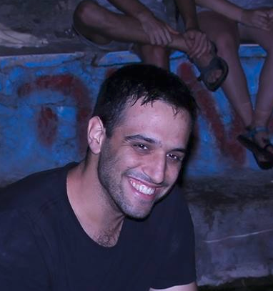



Diarization in practice
Yoav Ramon
ML Engineer at Hi.Auto
Yoav@hi.auto
Yoav Ramon
@YoavR7
@yoavramon

Slide 3


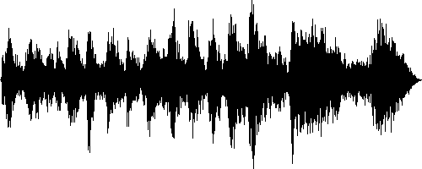
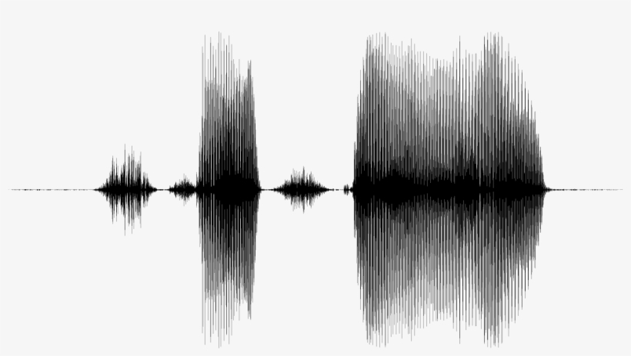
Audio-Visual Robust Speech Solution
=

Slide 4
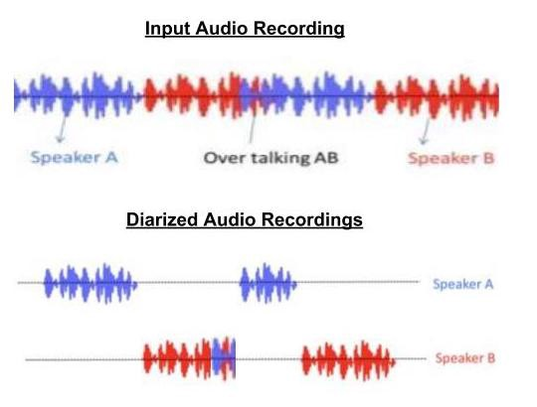
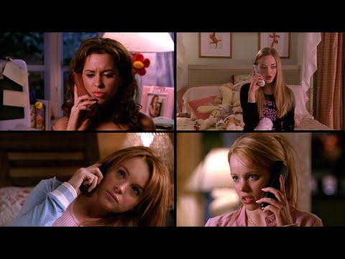
The Problem
Company
Context
Why it’s important?
Speaker identification
Speech Recognition
Real-world data analysis
“Who spoke when”
Diarization ≠ Speaker Separation

Slide 5

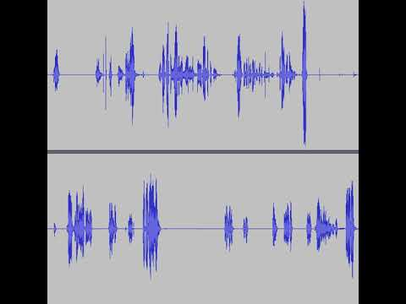
How good are we?
Callhome Challenge
Diarization with X-vectors
(Snyder, 2018)
DER
Without Oracle 8.39
With Oracle 7.12
Diarization with I-vectors
(Sell, 2015)
DER
Without Oracle 10.36
With Oracle 8.69
1997, 120 Calls, 2 Channels, Telephony 60 Hours +-

Slide 6
So… Is it solved?
“While state-of-the-art diarization systems perform remarkably well for some domains (e.g., conversational telephone speech such as CallHome), as was discovered at the 2017 JSALT Summer Workshop at CMU, this success does not transfer to more challenging corpora such as child language recordings, clinical interviews, speech in reverberant environments, web video, and speech in the wild” (Church et al., Feb. 2018)
Company
Context
DIHARD Challenge
Interspeech 2018, September
Development Test
Evaluation Test
Only 19 Hours
9 Domains (Child language, Supreme Court, Clinical interviews, Radio interviews, Map tasks, Sociolinguistic interviews, Meeting speech, Audiobooks, YouTube videos)
Single Channel
5 Minutes per sample
21 Hours
3 Different domains (Sociolinguistic interviews, Meeting speech, Restaurant conversation)
Single Channel
5 Minutes per sample

Slide 7
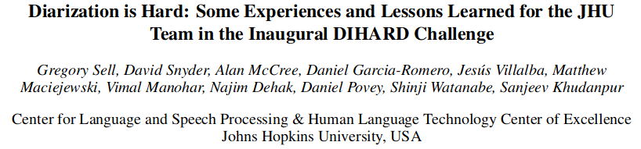
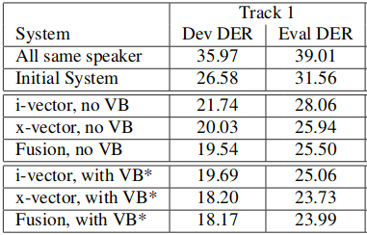
So… Is it solved?
Company
Context
Far from being solved...

Slide 8
Implementation
(So…. How do I do it?)

Slide 9
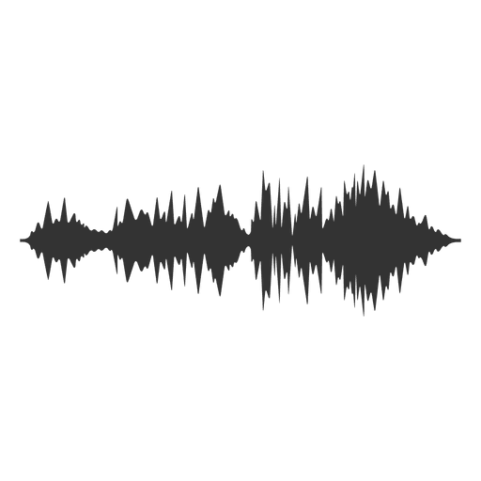
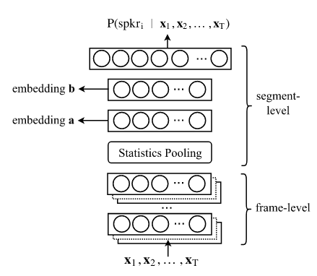
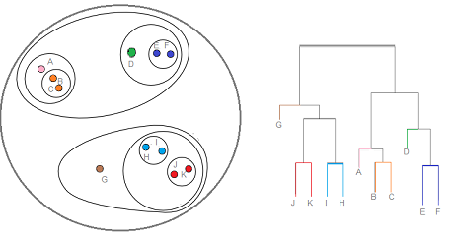
The framework:
Company
Context
Next Talk
Extraction
Vectorization
Normalization
Clustering

Slide 10
PLDA Normalization
Speaker 1
Speaker 2
Between-Speaker
Within-Speaker
Noise
Φ = μ + Vy + Ux + ϵ

Slide 11
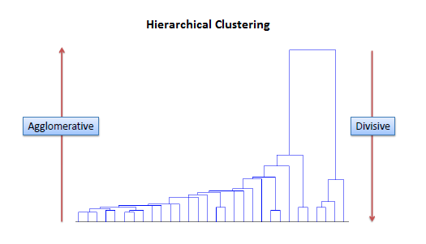
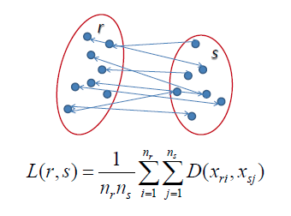
Agglomerative Clustering
With Oracle: Until we have enough speakers
Without Oracle: With Threshold

Slide 12
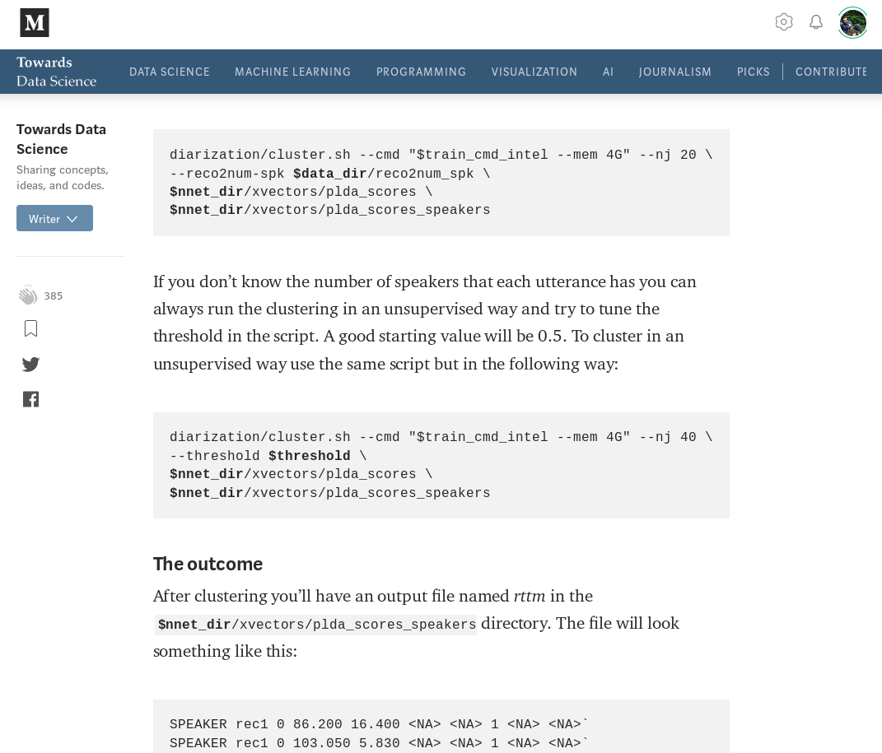
You can do it with Kaldi!
It’s easy to use
There are pretrained models
Although you’ll want to adapt them
There is support in clustering with oracle.
It’s easy to integrate inside speech processing pipeline
https://towardsdatascience.com/speaker-diarization-with-kaldi-e30301b05cc8

Slide 13
Challenges
Advantages
Real Time
Not good enough vectorization
Cross-Domain robustness (20% DER)
Estimating the number of speakers might be hard
Dimensionality reduction might create too-sparse vectors
Really Active research…
Not so hard to implement.
“Building Block” architecture leaves place to innovation.
The value to ASR Systems is huge, even with relatively poor DER
“Transfer Learning” on PLDA is easy

Slide 14
Thank you!
Questions?

